Slide 1
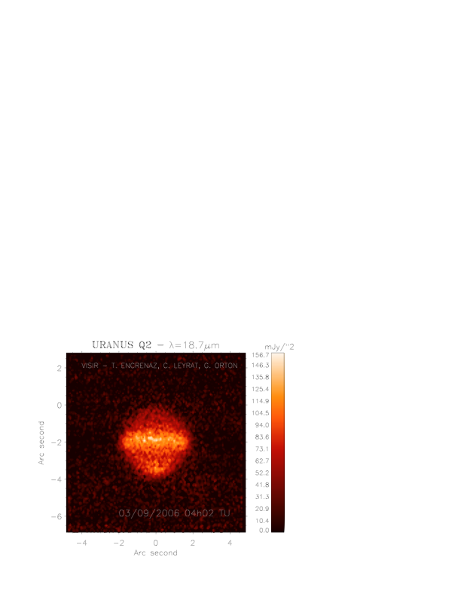
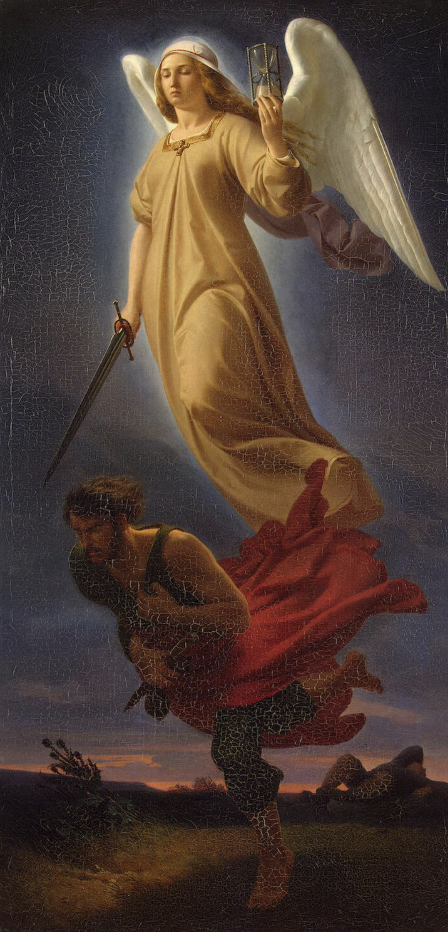
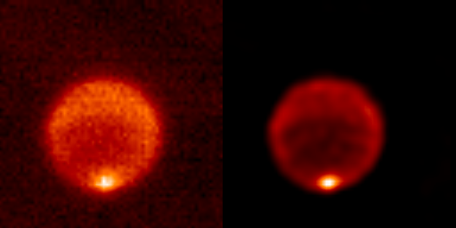
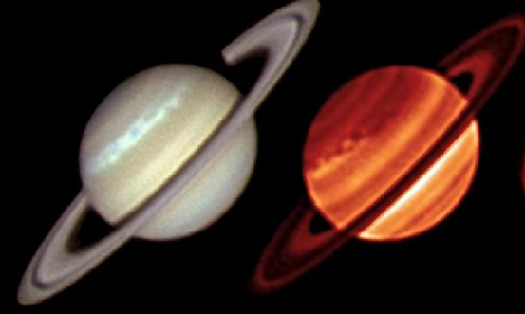

Thermal Emission of Giant Planets with NEMESIS
Fletcher, Irwin, Antunanu, Barstow, Blake, Donnelly, Giles, Melin, Nixon, Rowe-Gurney, Sinclair, Teanby

Slide 2
Contents
Brief Review of 5-µm to 50 cm Science
Mid-IR Retrieval Techniques & Tips
Discussion Points

Slide 3
NEMESIS and Giant-Planet Thermal Emission
M
N
Q
Far-IR
Sub-mm
Microwave
5 µm
7-16 µm
16-25 µm
25-200 µm
0.2-1.0 mm
1-50 cm
Imaging
VLT/CRIRES
Galileo/NIMS
Cassini/VIMS
Juno/JIRAM
IRTF/TEXES/MIRLIN/MIRSI
VLT/VISIR
Subaru/COMICS
SOFIA
Herschel/SPIRE/
Herschel/HIFI
VLA
(1.7-7 cm)
ALMA
(0.3-3.6 mm)
Voyager/IRIS
MWR
(1.3-50 cm)
Cassini/CIRS
Spitzer/IRS
JWST/MIRI

Slide 4
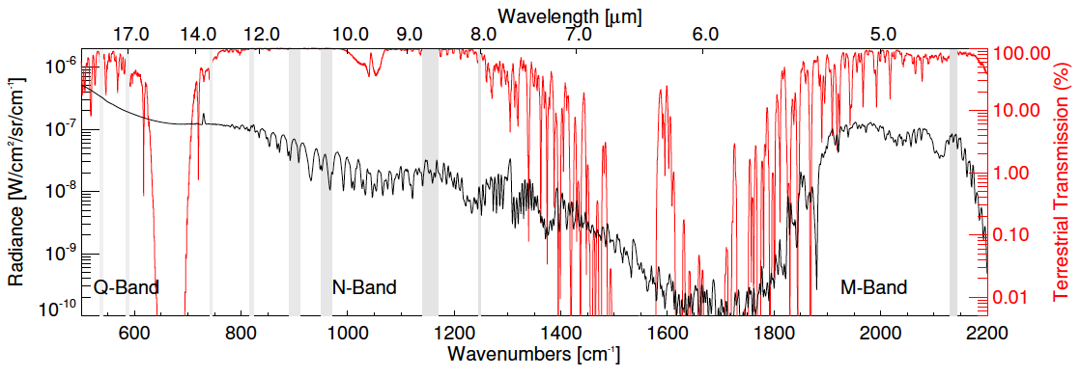
Mid-Infrared Science
Tropospheric Clouds
Tropospheric Thermometer (H₂)
Volatiles (NH₃)
Stratospheric Chemicals
Stratospheric Thermometer (CH₄)
Disequilibrium Species (PH₃)

Slide 5
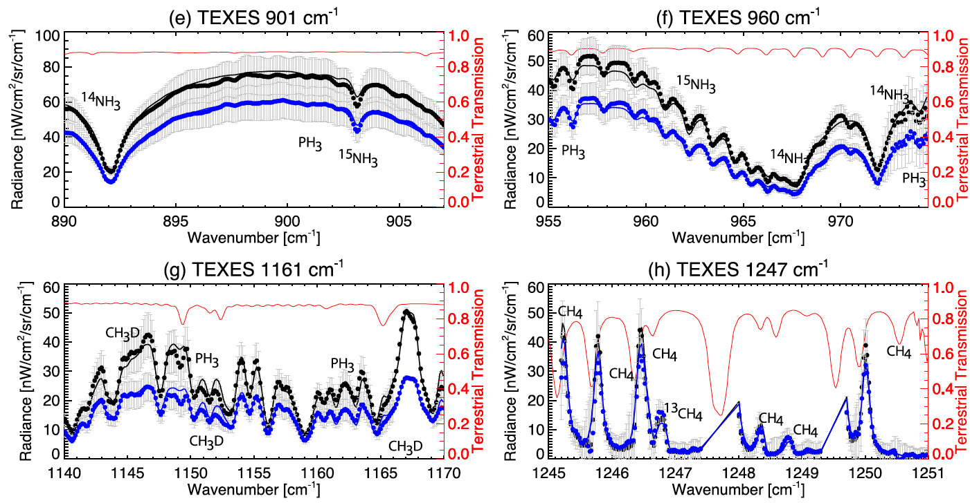
TEXES on the IRTF
Fletcher et al. (2016), https://arxiv.org/abs/1606.05498)
Every pixel is a full spectrum

Slide 6
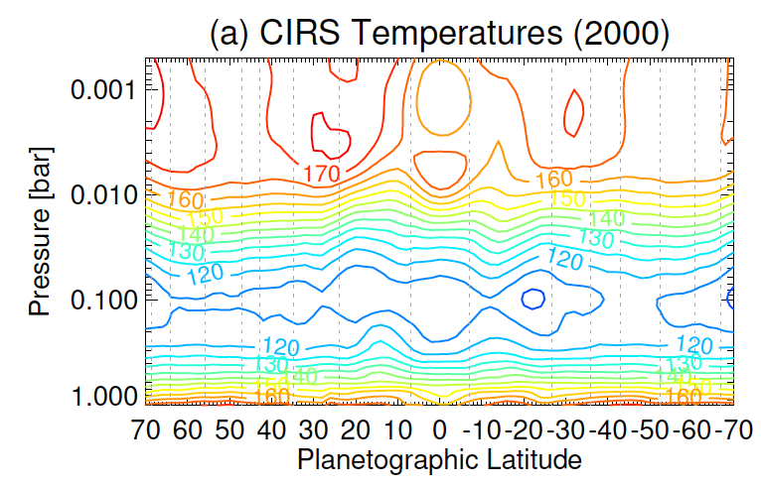
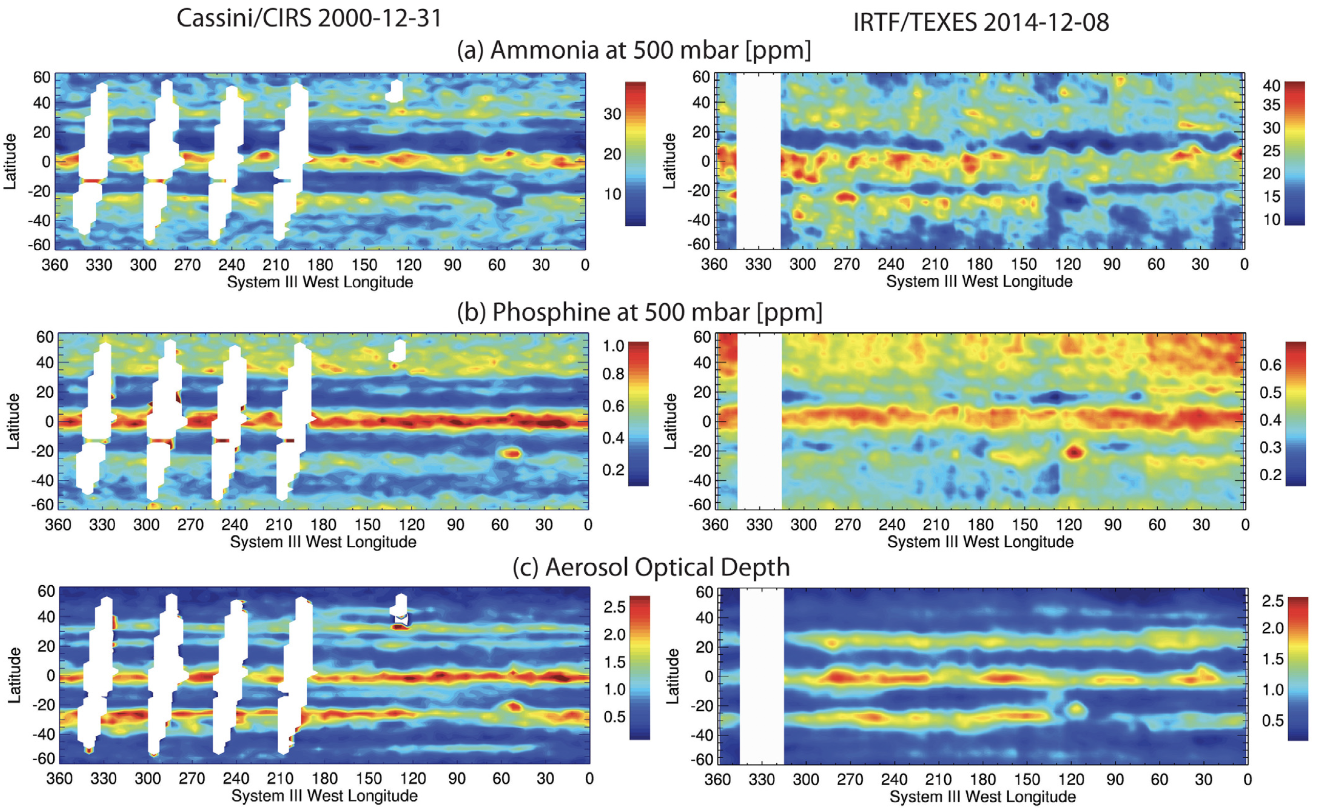
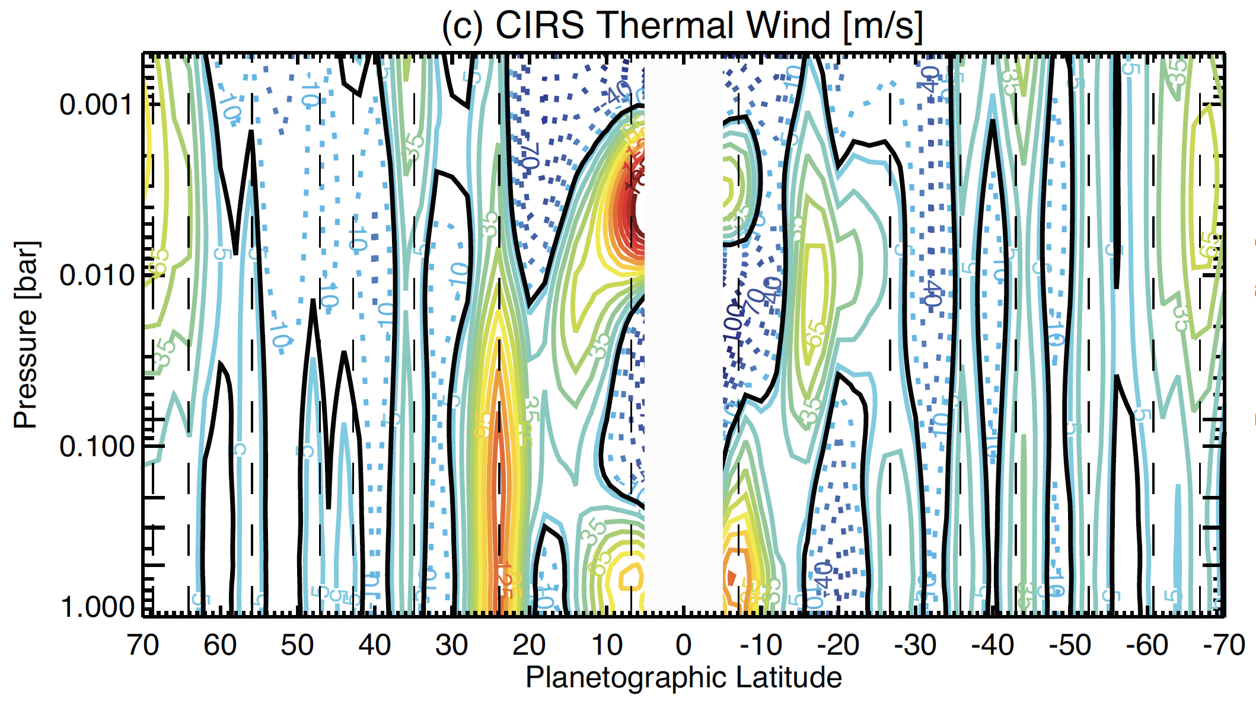
State of the Art: Temperature and Gas Mapping
Fletcher et al. (2016), https://arxiv.org/abs/1606.05498)

Slide 7
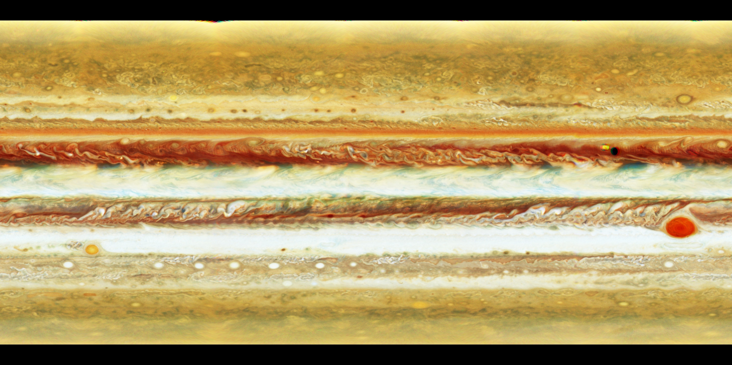
Next Step: From 3-m to 8-m Observatory
Hubble WFC3 2017-04-03
Gemini TEXES 2017-03-11
Moved TEXES from IRTF to Gemini in 2017.
Between PJ4 and PJ5.
Highest-resolution mid-IR spectral maps ever obtained.

Slide 8
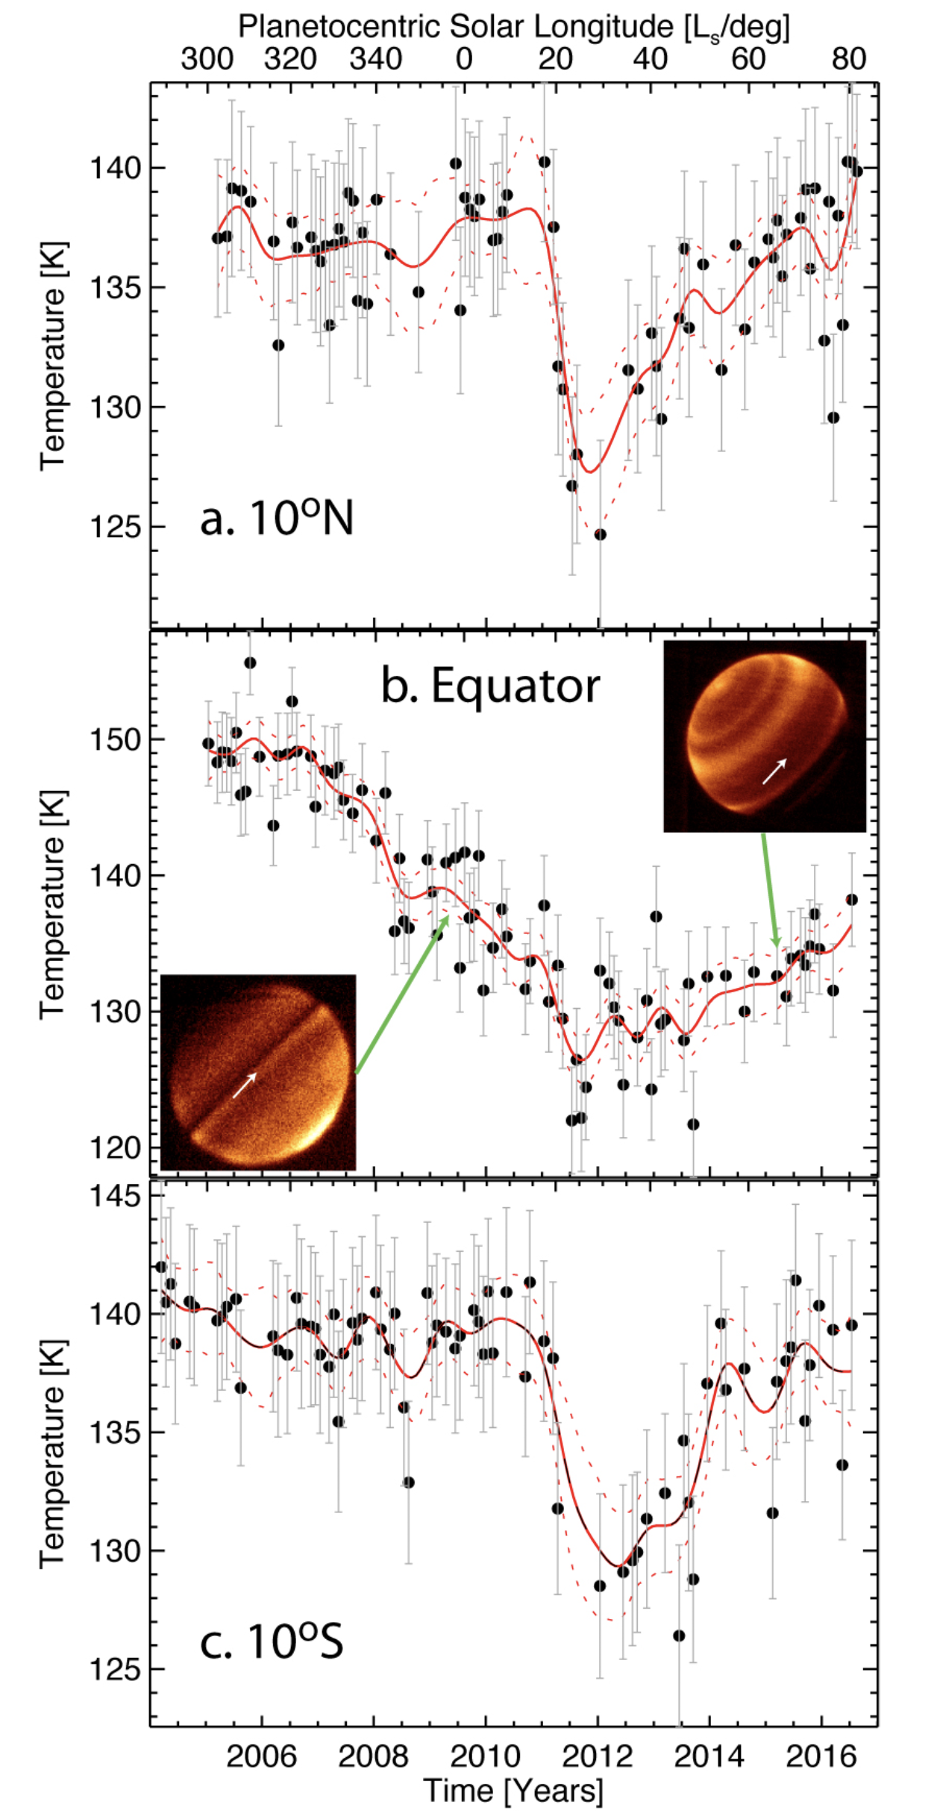
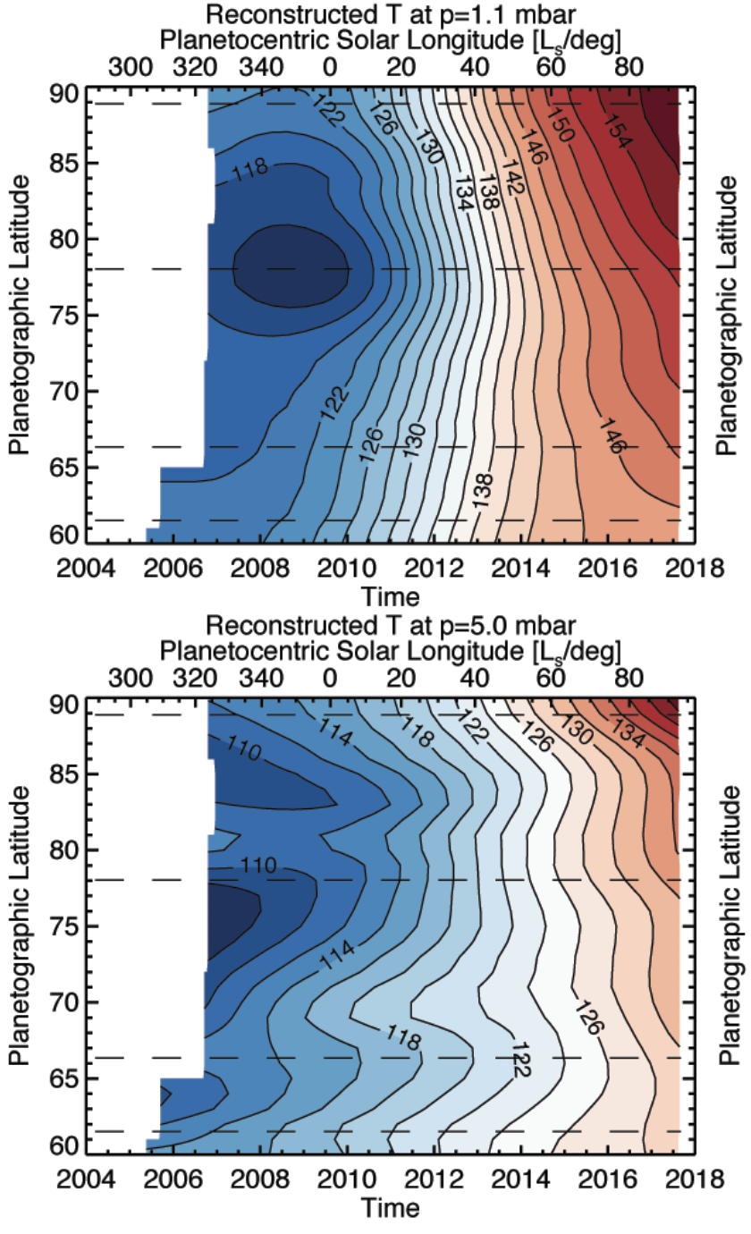
NEMESIS Techniques
Forward Models:
Correlated-k and line-by-line.
Discrete lat/lon and disc averaging.
Multi-emission angle
Scattering (sunlight on/off) at 5 µm; thermal emission elsewhere.
Ensembles of priors.
Post-processing:
polynomial or spline interpolation for time-series.

Slide 9
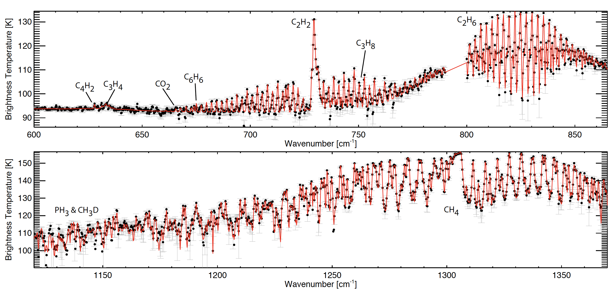
Ensembles of Priors
CIRS 0.5 cm-1 spectrum of north polar vortex, March 2017

Slide 10
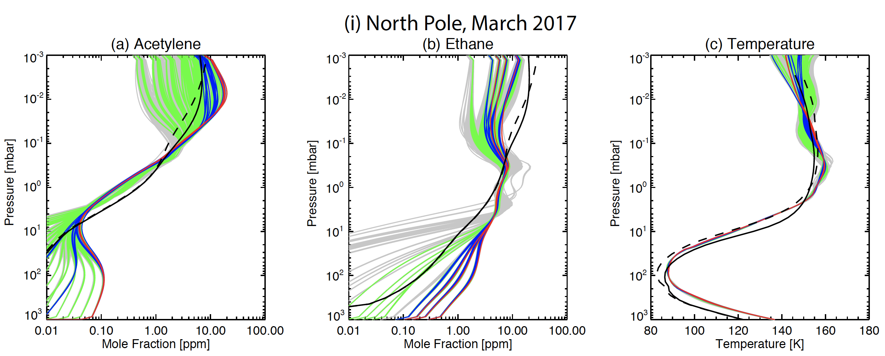
Ensembles of Priors
Parameterise prior temperatures (isotherms) and hydrocarbon abundances and rerun retrieval hundreds of times – a better uncertainty estimate.

Slide 11
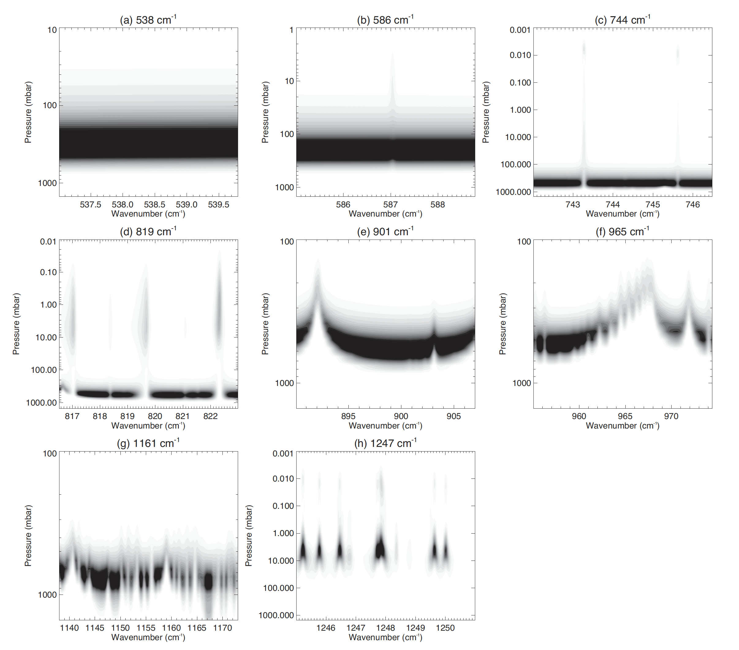
Multiple Steps, or Just One?
Multi-step retrievals:
T retrieval first with H2 or CH4.
Relies on T Jacobian covering same altitudes as gas Jacobian.
Single-step retrievals:
[+ ensemble of priors]
Preferred as emission can be explained by T changes away from H2/CH4 coverage.
Key question: do you really need to vary the gas?
Need to make assumptions about gas distributions…
TEXES Jacobians for Jupiter

Slide 12
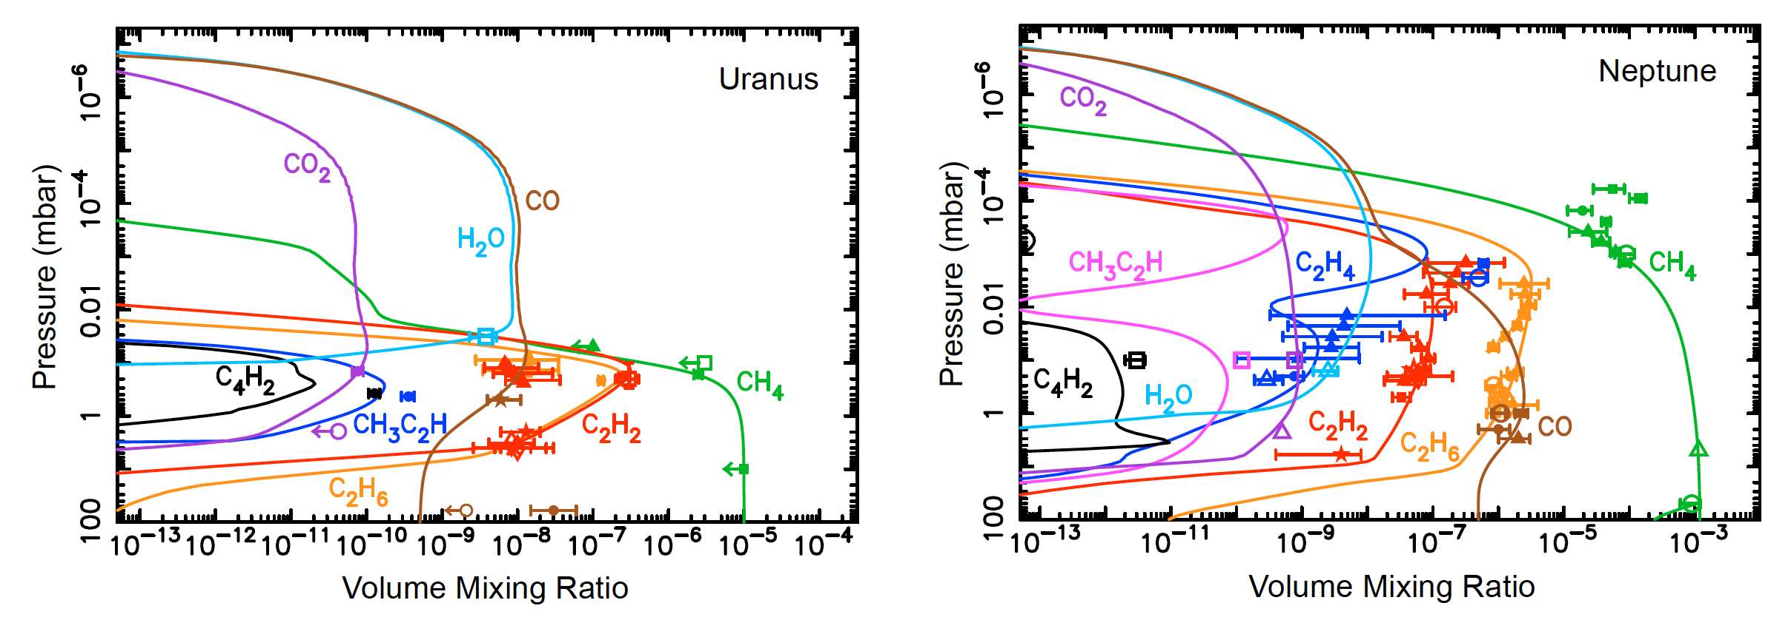
Gas Species: Hypothesis Tests
Moses and Poppe, 2017
See e.g., Giles et al. (2016, 2017); Melin et al. (2017)
Null: Gas is uniformly mixed in the horizontal.
HypA: Gas varies symmetrically from equator to pole.
HypB: Gas is asymmetric but doesn’t change with time.
HypC: Gas varies both spatially and temporally – full retrieval with scale factors.
HypD: Gas varies spatially, vertically, temporally…. Full retrieval of all profiles…
Want to be testing models, rather than blindly trusting retrieved gas abundances….

Slide 13
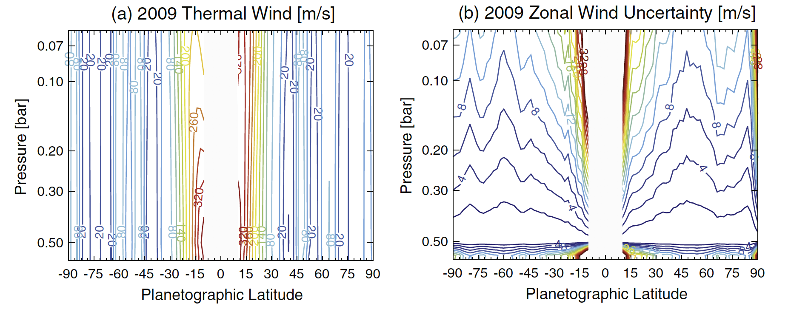
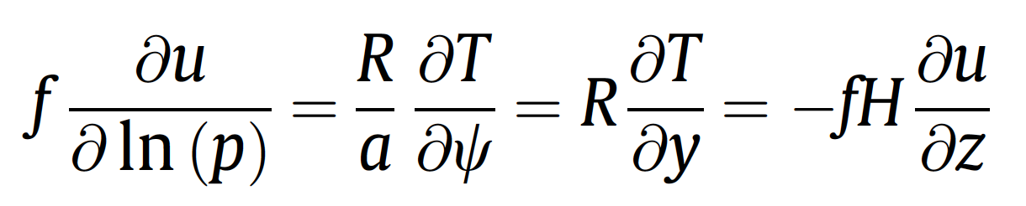
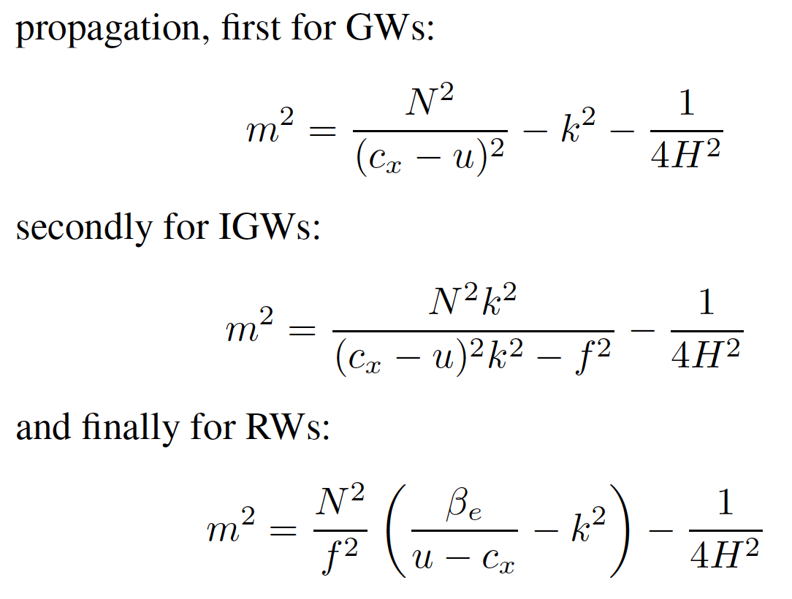
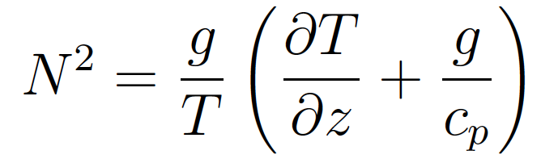
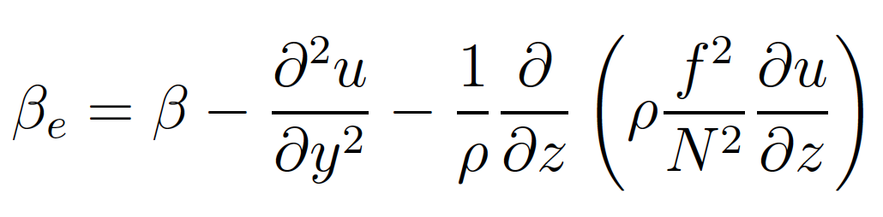
Note on Derived Parameters
3D temperature distributions can provide insights into background atmosphere:
Thermal Windshear Relation
Vertical propagation of diff. waves:
Buoyancy frequency/static stability
Vorticity gradients
…but gradients of T in vertical and horizontal magnifies errors, so don’t always believe what you see!!

Slide 14
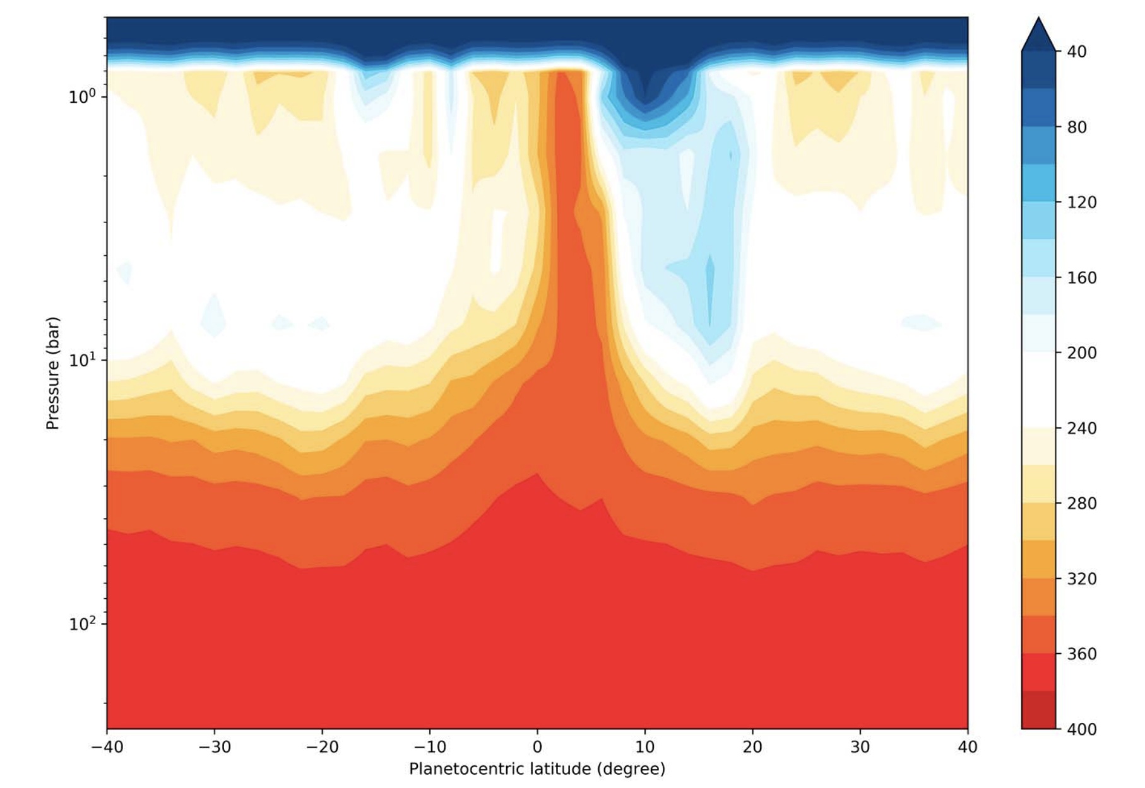
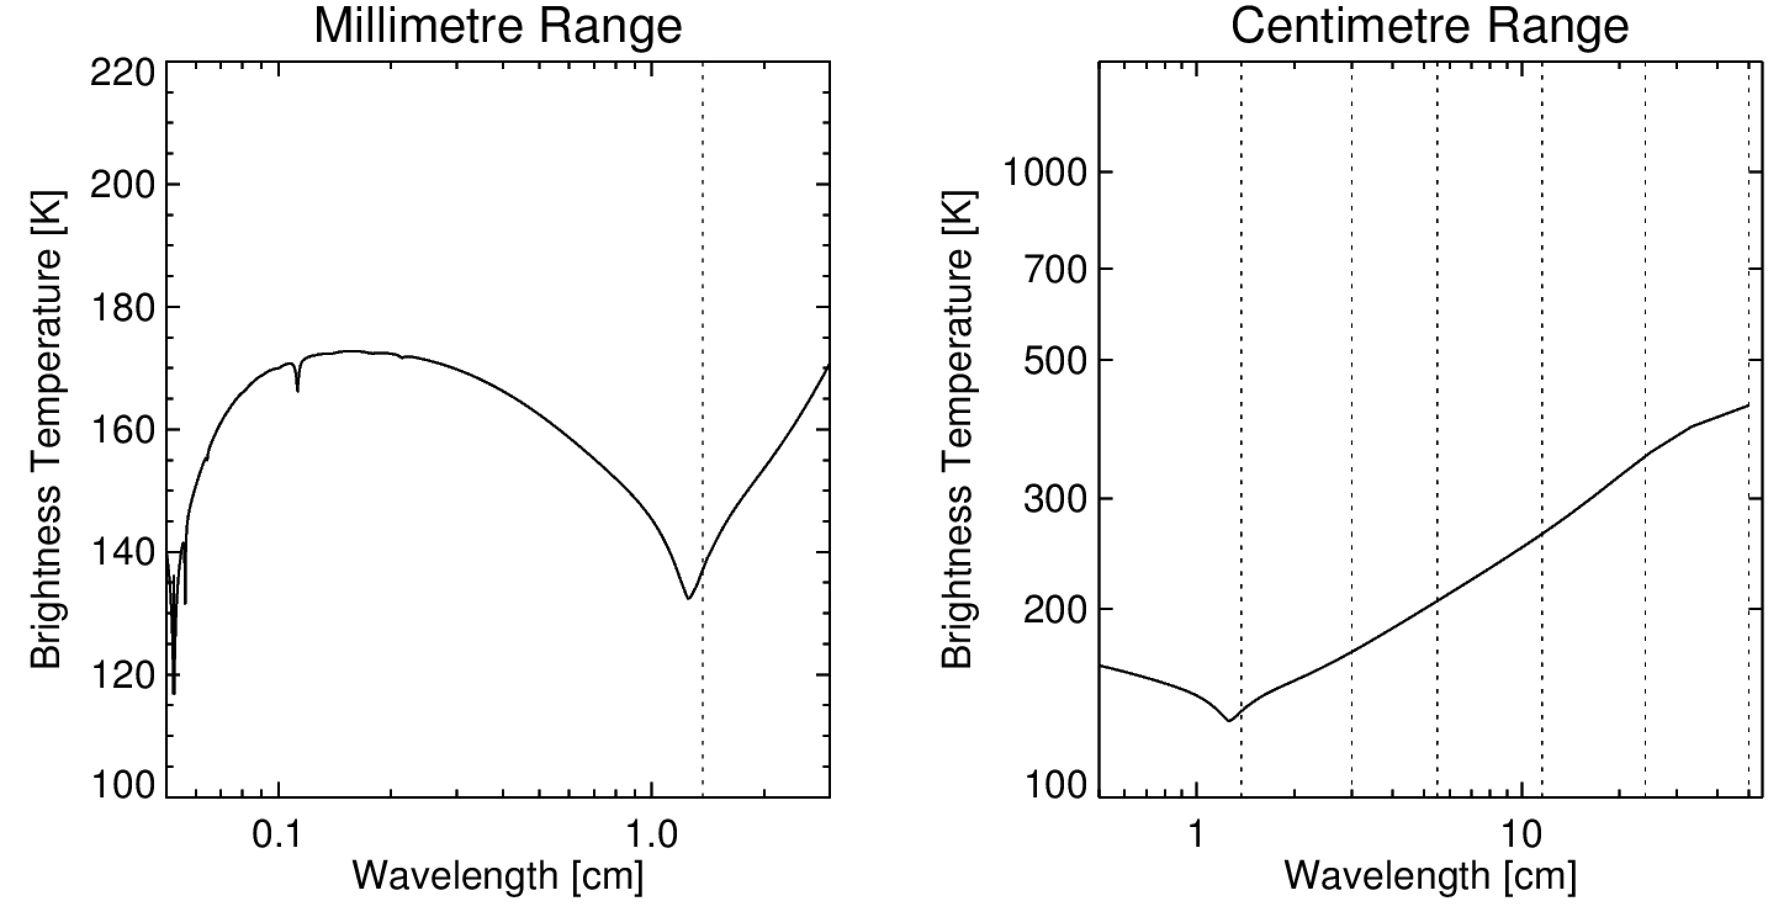
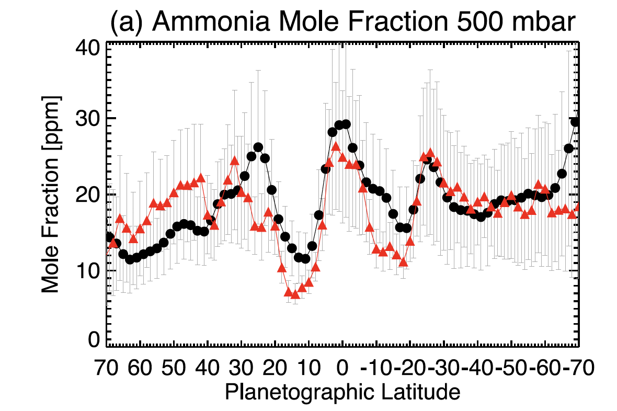
Work in Progress: Microwave
Working with Imke de Pater (VLA and ALMA) and MWR team.
Hope to solve NH3/T issues by combining mm/cm/µm retrievals.
NEMESIS struggling at centimetre wavelengths:
Issue with v. small wavenumbers?
Incorrect lineshapes for NH3 inversion band?
Li et al. (2017) – Juno MWR
Fletcher et al. (2016) - TEXES

Slide 15
Discussion Points
Condensation and lapse rate
Error Handling
Radiative heating/cooling
Non-LTE
Memory Issues
Minor Annoyances
Proper Use of GitLab
NEMESIS in UV
Scattering Set-Up

Slide 16
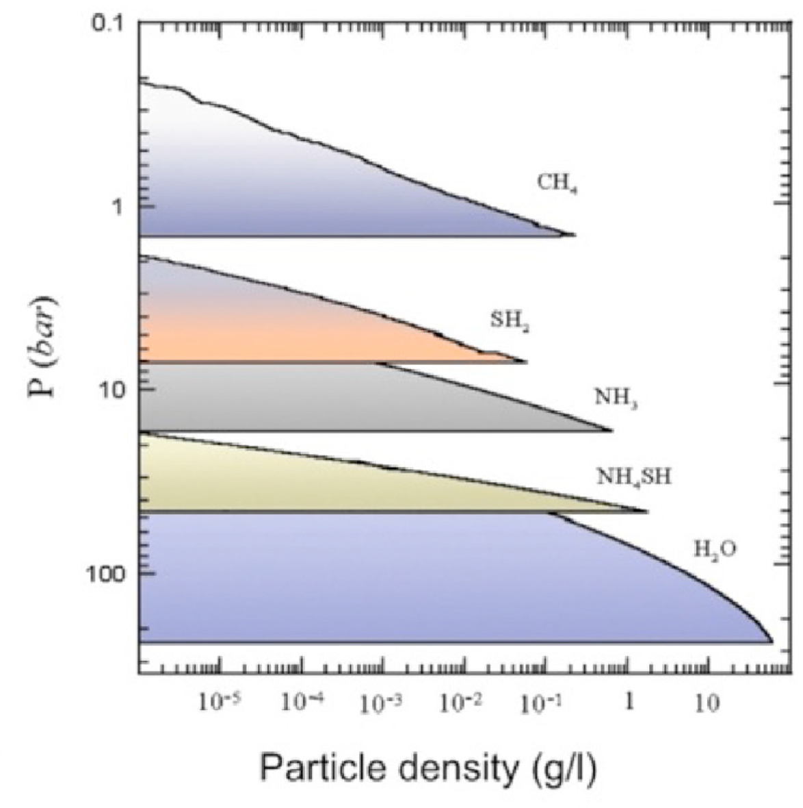
Condensation and Lapse Rate
Feedback between condensation and T(p):
Volatile condensation releases latent heat (CH4, NH3, H2S).
Reaction (NH3+H2S) releases heat exothermically.
Can we include this in T(p) in self-consistent way?
Parameterised Temperatures:
Any way to retrieve just a lapse rate, and then extrapolate?
Or a full profile for p<p_{ref} and a lapse rate for p>p_{ref}?

Slide 17
Error Handling
Can we improve error outputs?
Provide 1, 3-sigma errors?
Some way of accounting for vertical profile uncertainties when we scale/parameterise gases?
Anything else we can do to ‘trust’ the output errors?

Slide 18
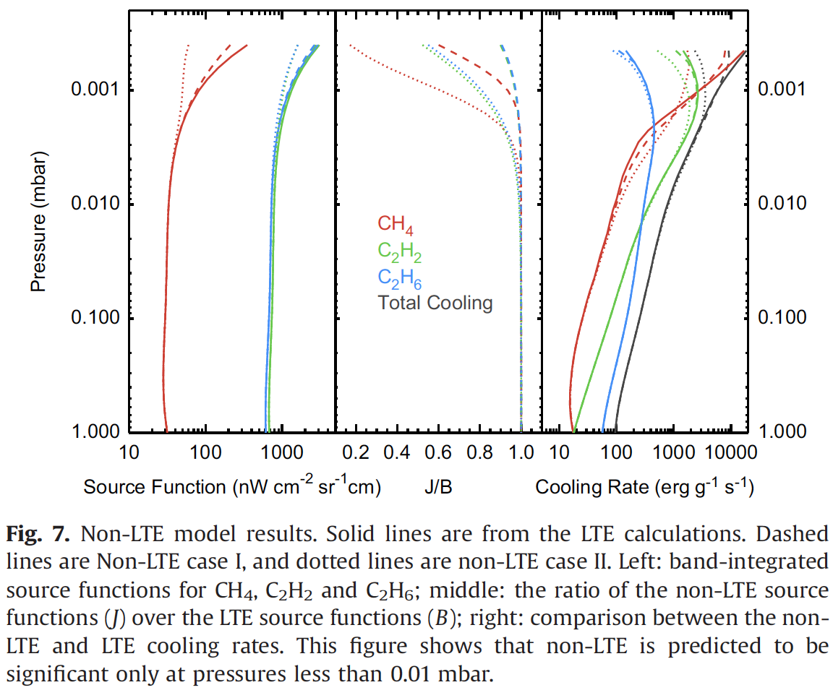
Radiative Heating/Cooling
With sufficiently broad k-tables, NEMESIS has all it needs to calculate heating/cooling rates as a function of height.
Any way to have this output, as a function of latitude/altitude?
Would need to know solar illumination conditions….
Allow us to address energy balance issues in middle atmosphere…
Zhang et al., 2013

Slide 19
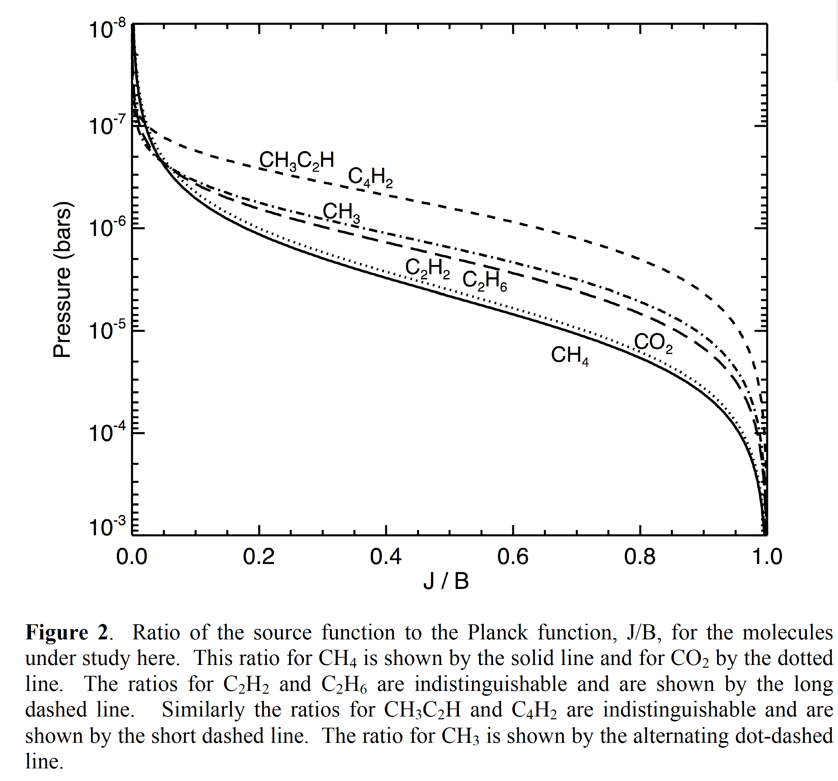
Addition of Non-LTE
Orton et al. (2014) Uranus papers used code from Martin-Torres et al. (1998) to estimate J/B ratios.
Needed for p<0.1 mbar
Radtran/calc_nlte.f contains some code from 1994…
How to best include in NEMESIS?

Slide 20
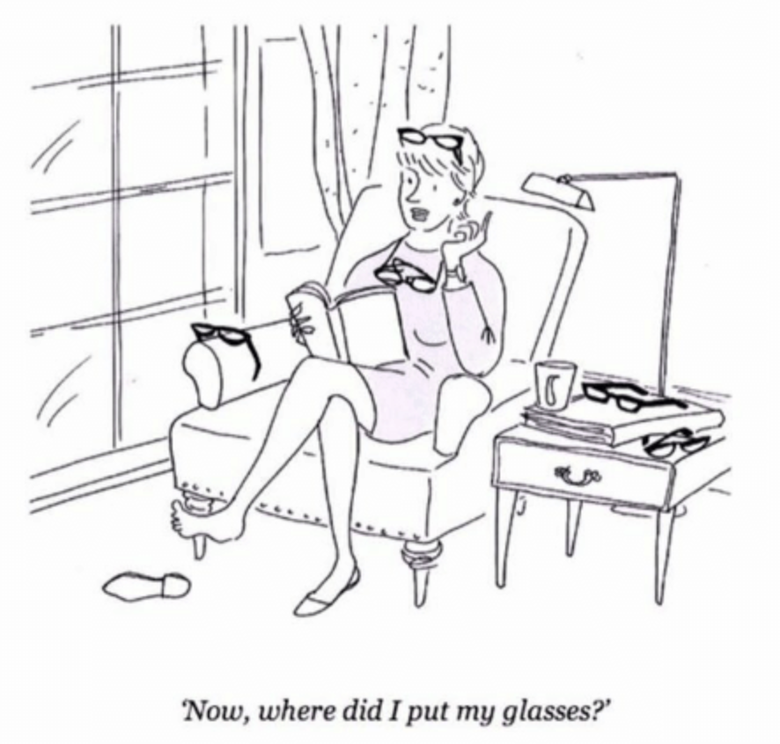
NEMESIS Memory Issues
Updates to double precision, plus need for more paths/spectral points have increased memory size:
additional relocation overflows omitted from the output
collect2: error: ld returned 1 exit status
make: *** [Nemesis] Error 1
GFORT complains and refuses to compile; IFORT lets you continue.
Need a solution that works for all.
Trimming array sizes in includes/arrdef.f until something works is sub-optimal.

Slide 21
Minor Annoyances
Different REF/PRF formats
REF files and PRF files differ by a single line (number of latitudes).
Is this necessary, and can it be changed?
Always having to change isys.f and datarchive.f whenever I update.
Having so many input files:
I just have all mine specified in a wrapper file.
Do we really need gettime.c?
Do we really need FOVgreg?

Slide 22
Proper use of GitLab?
Git pull origin
Always tells me that I have local changes that will be overwritten by a merge, so aborts.
Git stash save
Supposed to just save the working directory, but reports something about “merging to branch master” which sounds dangerous!
Git status
Tells me I’m ahead by N commits, but just commiting those changes doesn’t necessarily mean they’re published, right?
Git commit
Adds the new files, but where are they stored if they’re not “pushed to the origin”
Git push
Adds all the committed files to the main repository and sends an email.
Could/should we use GitLab for ktables/linedata?

Slide 23
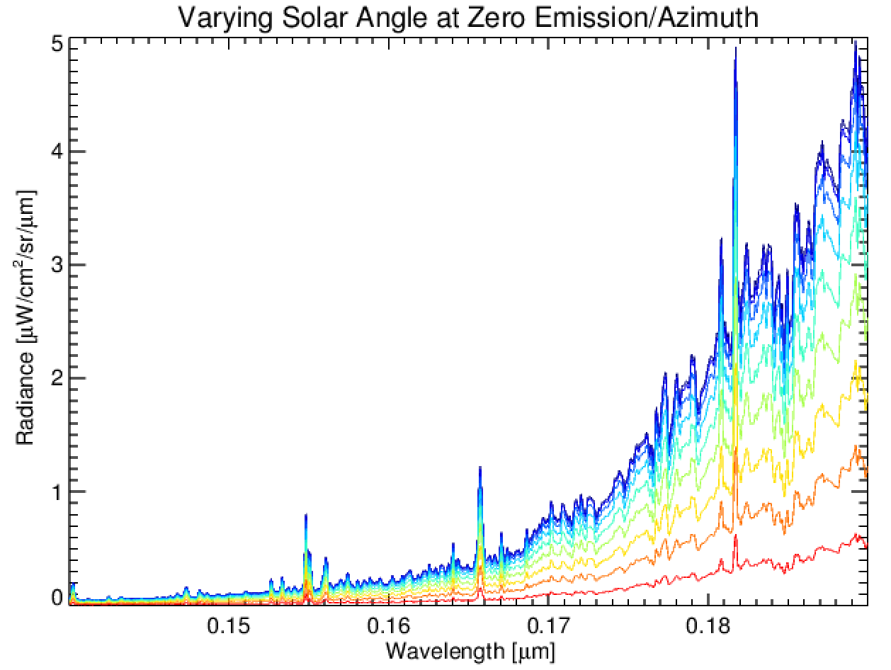
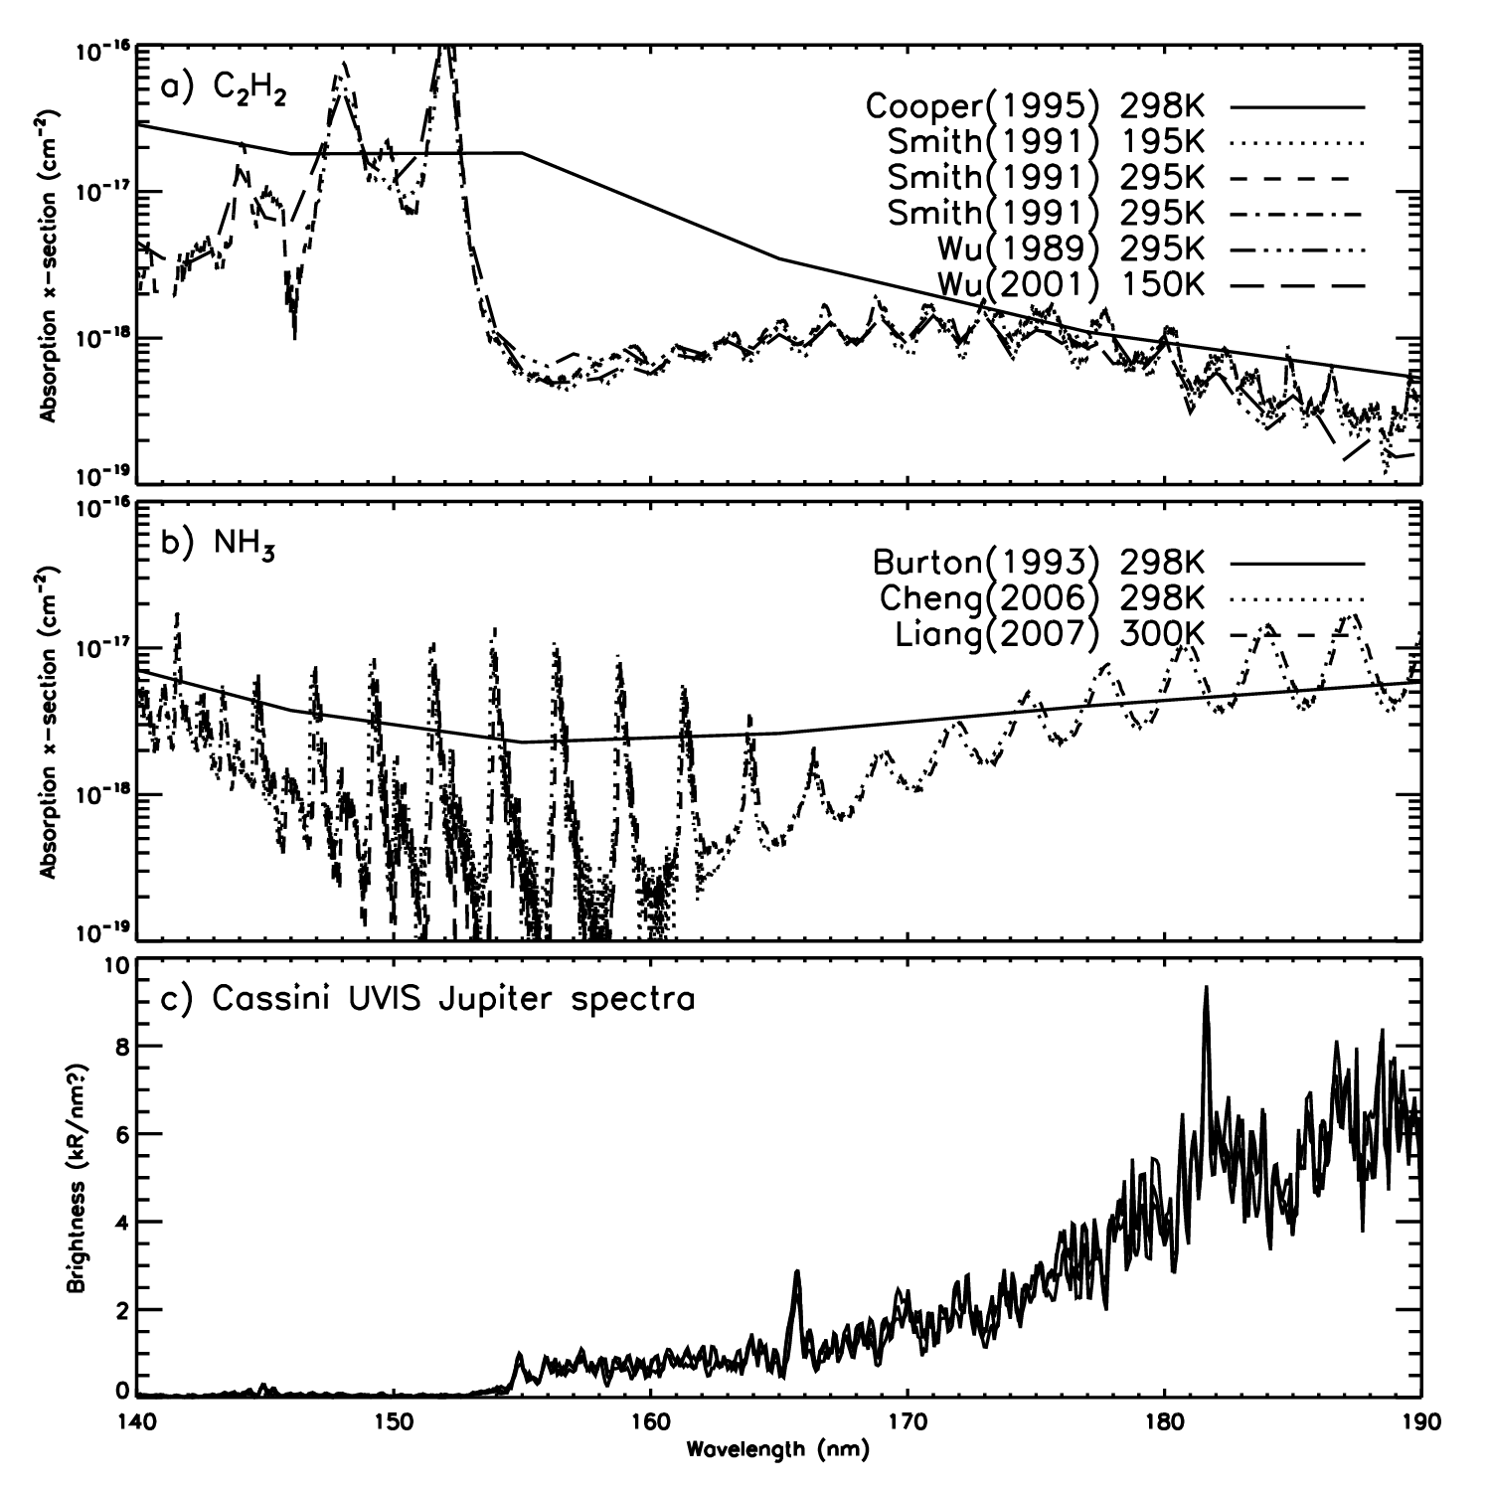
NEMESIS in UV
Plan to introduce cross-sections in the same way as Ozone
Better suggestions?
Best sources of UV cross-sections?
What’s the minimum wavelength where reliable CH4 tables exist?
Ashwin’s MUSE tables go down to 0.4 µm.
Karkoschka’s CH4 continuum goes down to 0.3 µm.
Anything from Exomol useful here?

Slide 24
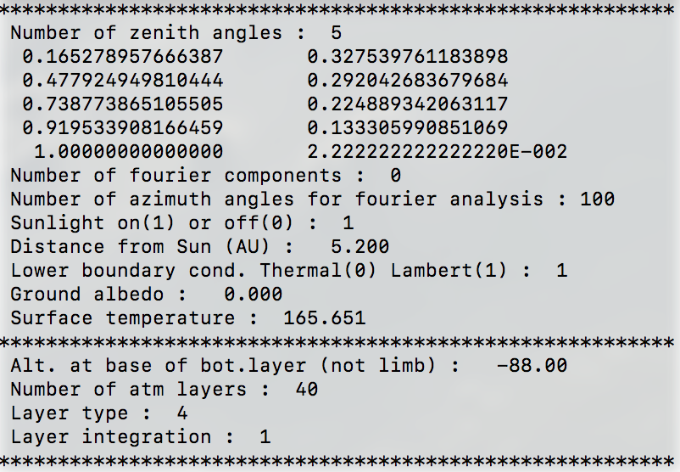
*.set files – Layer Height and Scattering?
The runname.set files want to have a layer height specified for the deepest layer
But this is not, apparently, the bottom of the model.
So what guides the choice?
A selection of azimuth angles is currently hard-wired – what’s the right choice here?

Slide 25
K-Table Snapping – Stop It!
For TEXES, Spitzer, and others, we preconvolve the ktables (using variable resolution with wavelength) and then set FWHM in the *spx file to zero.
BUT:
NEMESIS tries to find and snap to the nearest wavelength in the ktables.
Prefer to interpolate between the ktables positions, as we do for standard FWHM.ne.0 cases!

Slide 26
K-Tables: Carrying the Wavelength
For TEXES, we have multiple small wavelength chunks, each convolved to a different spectral resolution.
BUT:
We still have to keep the same DELV for each section of the table so that we can combine them.
Do/can we just carry irregularly-gridded wavelengths with the ktables?

Slide 27
End

